Slide 1

Become a Better C# Developer DevIntersection April 2022
Kathleen Dollard
Principal Program Manager, Microsoft
@kathleendollard
Leslie Richardson
Program Manager, Microsoft
Andrew Hall
Senior Software Engineer, Microsoft

Slide 2
Agenda
8:00-9:15 | Introduction, C#, a few puzzles
9:15-9:30 | Break
9:30-10:45 | Debugging and light profiling
10:45-11:00 | Break
11:00-12:15 | Puzzles
12:15-1:15 | Lunch
1:15-2:20 | Newer C# features with help from Visual Studio
2:20-2:30 | Short break
2:30-3:00 | Summary

Slide 3
Agenda
8:00-9:15 | Introduction How we think about C# evolution (4 buckets) Puzzle: Value/ref and equality/etc. Puzzle: Purity/string interpolation
9:15-9:30 | Break
9:30-10:45 | Debugging and light profiling
10:45-11:00 | Break
11:00-12:15 | Puzzles
12:15-1:15 | Lunch
1:15-2:20 | Newer C# features with help from Visual Studio
2:20-2:30 | Short break
2:30-3:00 | Summary

Slide 4
C# Evolution
Mads Togersen discussing the C# design process at the Languages and Runtime Community Standup https://aka.ms/csharp-design-process-standup

Slide 5
We innovate to …
Increase your productivity, make it easier to write and understand code
Make it easier to write resilient apps
Improve performance of your application and your dev experience
Empower new scenarios

Slide 6
Goals for C# evolution
Productivity
Resiliency
Shortened property syntax, patterns
Null reference types, required keyword
Performance
New scenarios
Often aimed at speeding up the .NET runtime
UTF8, Maui interop scenarios

Slide 7
Releasing big features over multiple releases makes better features
Patterns
Null reference types
Memory improvements (span/ref/pointer work)
Statics in interfaces
INumber, IParseable, etc. constraints

Slide 8

Puzzles!

Slide 9

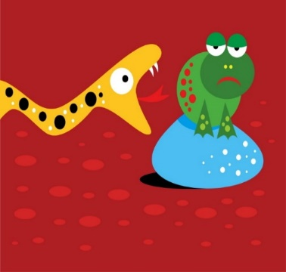
Cognitive Dissonance
Learning includes breaking old associations
Your brain contorts to fit new input into existing perception
That’s being human
How do we break this?
Humor
Horror, trauma
Explicit incorrectness
Clarify your model
Show it’s wrong
Or confirm it’s right
Verbalizing to another
Empathy
Forced clarity

Slide 10
Cognitive Dissonance
Learning includes breaking old associations
Your brain contorts to fit new input into existing perception
That’s being human
How do we break this?
Humor
Horror, trauma
Explicit incorrectness
Clarify your model
Show it’s wrong
Or confirm it’s right
Verbalizing to another
Empathy
Forced clarity

Slide 11

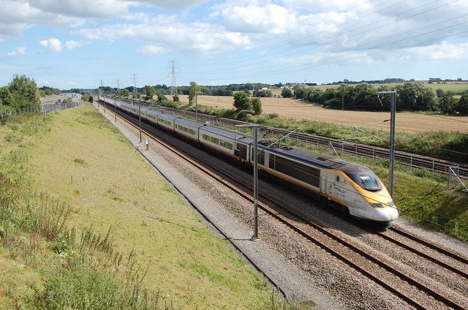
Cognitive Dissonance
Learning includes breaking old associations
Your brain contorts to fit new input into existing perception
That’s being human
How do we break this?
Humor
Horror, trauma
Explicit incorrectness
Clarify your model
Show it’s wrong
Or confirm it’s right
Verbalizing to another
Empathy
Forced clarity

Slide 12
Cognitive Dissonance
Learning includes breaking old associations
Your brain contorts to fit new input into existing perception
That’s being human
How do we break this?
Humor
Horror, trauma
Explicit incorrectness
Clarify your model
Show it’s wrong
Or confirm it’s right
Verbalizing to another
Empathy
Forced clarity

Slide 13
Cognitive Dissonance
Learning includes breaking old associations
Your brain contorts to fit new input into existing perception
That’s being human
How do we break this?
Humor
Horror, trauma
Explicit incorrectness
Clarify your model
Show it’s wrong
Or confirm it’s right
Verbalizing to another
Empathy
Forced clarity

Slide 14
Puzzle groups
Two or three people
Generally, not the people you came with
If you think you’re good, pair with someone you think might struggle
I’ll set out a puzzle in the form of a unit test
It will require a change to create a meaningful passing test
The discussion of ‘why’ is the important aspect
There’s a time for everything
I want you to think, not experiment

Slide 15

DEMO
Puzzles!!

Slide 16
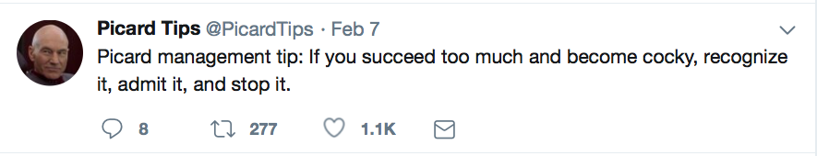

Slide 17
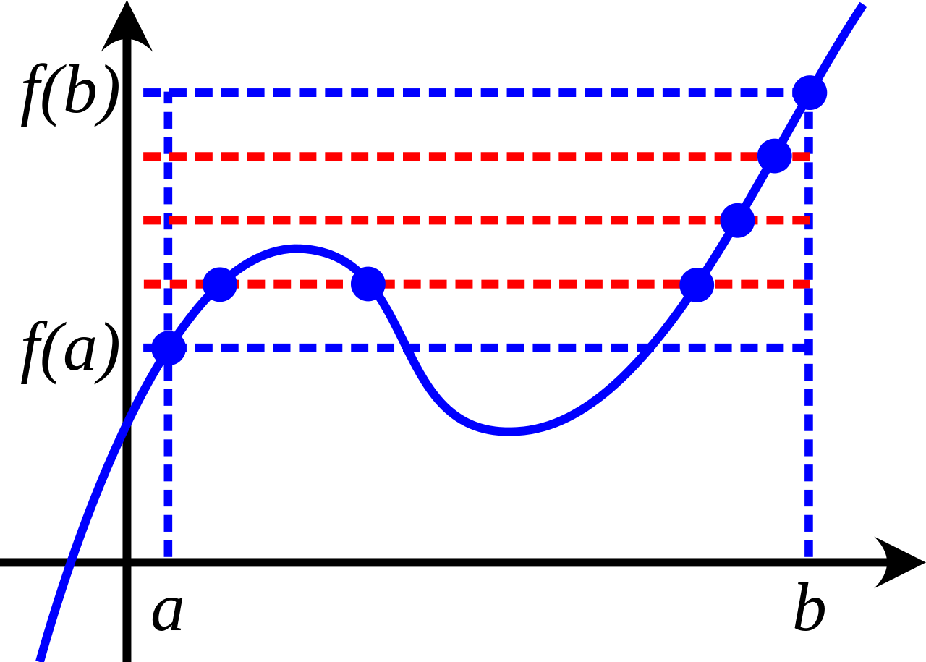
Intermediate to Advanced
We all know more about some things and less about others
We always wonder what we’re missing
New learning “sticks” better in the context of fundamentals
I hope this workshop will be a great close to the conference
But you’ll forget a lot by Monday
Link to materials and summary
This Photo by Unknown Author is licensed under CC BY-SA
https://github.com/KathleenDollard/DevIntersection2022

Slide 18

Break

Slide 19
Debugging
Kathleen on thinking
Leslie on using tools
Profiling is different

Slide 20
Code is hard to debug when you can’t read the code
Code is hard to debug when the symptom (issue) is distant from the problem (bug) in time or space
Code is hard to debug when the context causing the bug is transitory
Code is hard to debug when someone gave you incorrect or misleading information

Slide 21
Debugging Strategies
Divide and Conquer
Scientific Method
A good debugging strategy is any strategy you can articulate and repeat

Slide 22
A Debugging Strategy Scientific Method
Repro, think, write test
Something Happens
Can you repro in Visual Studio?
Create several hypotheses
Yes
Select one to disprove
Outside production?
Run experiment
Evaluate

Slide 23
Scientific Method Walkthrough

Slide 24
Collaborative Debugging Game
One person imagines a bug. Be VERY specific. Know exactly the broken code and exactly what would happen
Helps if it’s a bug you’ve stumbled with
Everyone else works together to solve the bug by asking what would happen if they ran certain VERY specific tests
The person imagining the bug may well make mistakes. Be patient. You’ll also make mistakes and go down rabbit holes in the real world.
Take turns imagining the bug

Slide 25
A Debugging Strategy Scientific Method
Repro, think, write test
Something Happens
Can you repro in Visual Studio?
Create several hypotheses
No
Yes
Select one to disprove
Outside production?
Run experiment
Evaluate
Notes:
Leslie on tooling

Slide 26
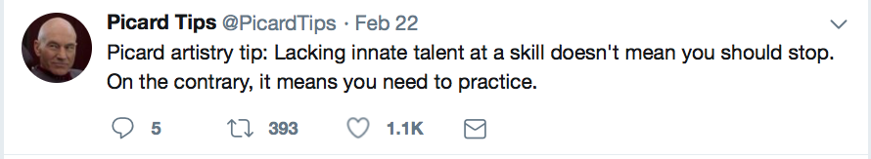

Slide 28

Profiling vs. Debugging
Debugging behavior that you can reproduce
Think, explore, act, <repeat> (Scientific method)
Solving performance problems
Create measurements and goals
Explore, think, act, <repeat>
VS gives you awesome ways to explore
Consider upgrading runtime and libraries
Debugging behavior you cannot repro out of prod
Explore, think, explore, <repeat>, act

Slide 29
Break

Slide 30

Protect from Murphy not Machiavelli
This is a comment on code resiliency, not security.

Slide 31
DEMO
Puzzles!!

Slide 32

DEMO
Patterns!!

Slide 33
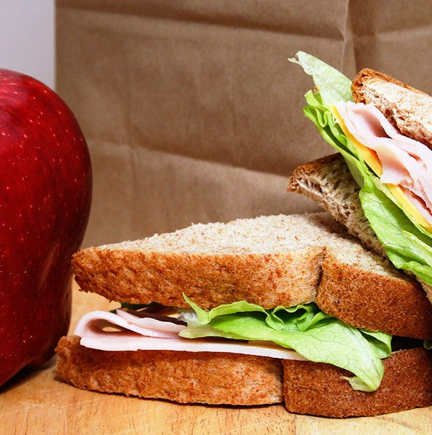
Lunch

Slide 34
DEMO
Puzzles!!

Slide 35

DEMO
Productivity

Slide 36
Break

Slide 37
Async – Avoid async void
Use this ONLY for event handlers
Information on any errors is swallowed
try catch
Either: recover or quit with logging
If you do nothing, or do nothing and crash the app with little info

Slide 38
Embrace the viral nature of async!
Do not using .Result or .Wait or variations
The task must be awaited by something useful
Desktop – message loop responsive to other requests
Web – ASP.NET can reuse the thread

Slide 39
Why use async?
Desktop
Responsiveness
UI does not appear frozen
User can press cancel
You can sometimes post progress
May need to disable inappropriate features
Web
Throughput
Return thread to ASP.NET
Requires state unload/reload
If the value is ready, process continues

Slide 40
CPU bound operations
Desktop
Use Task.Run
Maximize responsiveness
Get off the main thread
Web
DO NOT USE Task.Run
Maximize throughput
Avoid expensive thread switching
Exception to rule: Parallel calculations where latency is more important than throughput

Slide 41
ConfigureAwait(false)
Task normally switches to calling thread for continuation(*)
You can avoid this task switch with ConfigureAwait(false)
This has a minor performance improvement
Importance generally overstated
Do not use ConfigureAwait in library code!
It might be used by a desktop app, which will not continue correctly
(*) Continuation is code after await

Slide 42
Links to code
My GitHub repo has a bunch of junk and things that are half done. This will help you find what you want:
Puzzles: Look for the correct branches
https://github.com/KathleenDollard/sample-puzzles
Async breakfast is in this repo
Sample profiling problem:
https://github.com/KathleenDollard/sample-profiling-problem
If you mess with the numbers in Main, you can create a GC problem
My version of toll calculator – final branches for both workshop and session
https://github.com/KathleenDollard/sample-csharp-8
Use start-working if you want to do the walk through

Slide 43
Resources @KathleenDollard (in my repos, be sure you get the right branch!!!)
Summary.txt for our wrap up
Puzzles code on GitHub: https://github.com/KathleenDollard/sample-puzzles/tree/start-devintersection-2021
Pattern matching: https://github.com/KathleenDollard/sample-patterns/tree/devintersection-2021-start
Docs tutorial version of Toll Calculator
https://docs.microsoft.com/en-us/dotnet/csharp/tutorials/pattern-matching
Docs tutorial on arithmetic and other details (marked as beginner)
https://docs.microsoft.com/en-us/dotnet/csharp/

Slide 44

Summary

Slide 45
Extras

